Slide 1
using the ethz computer cluster
Lab meeting 21/09/2020
Bernat Bramon Mora
ETH Zürich
Plant Ecology group

Slide 2
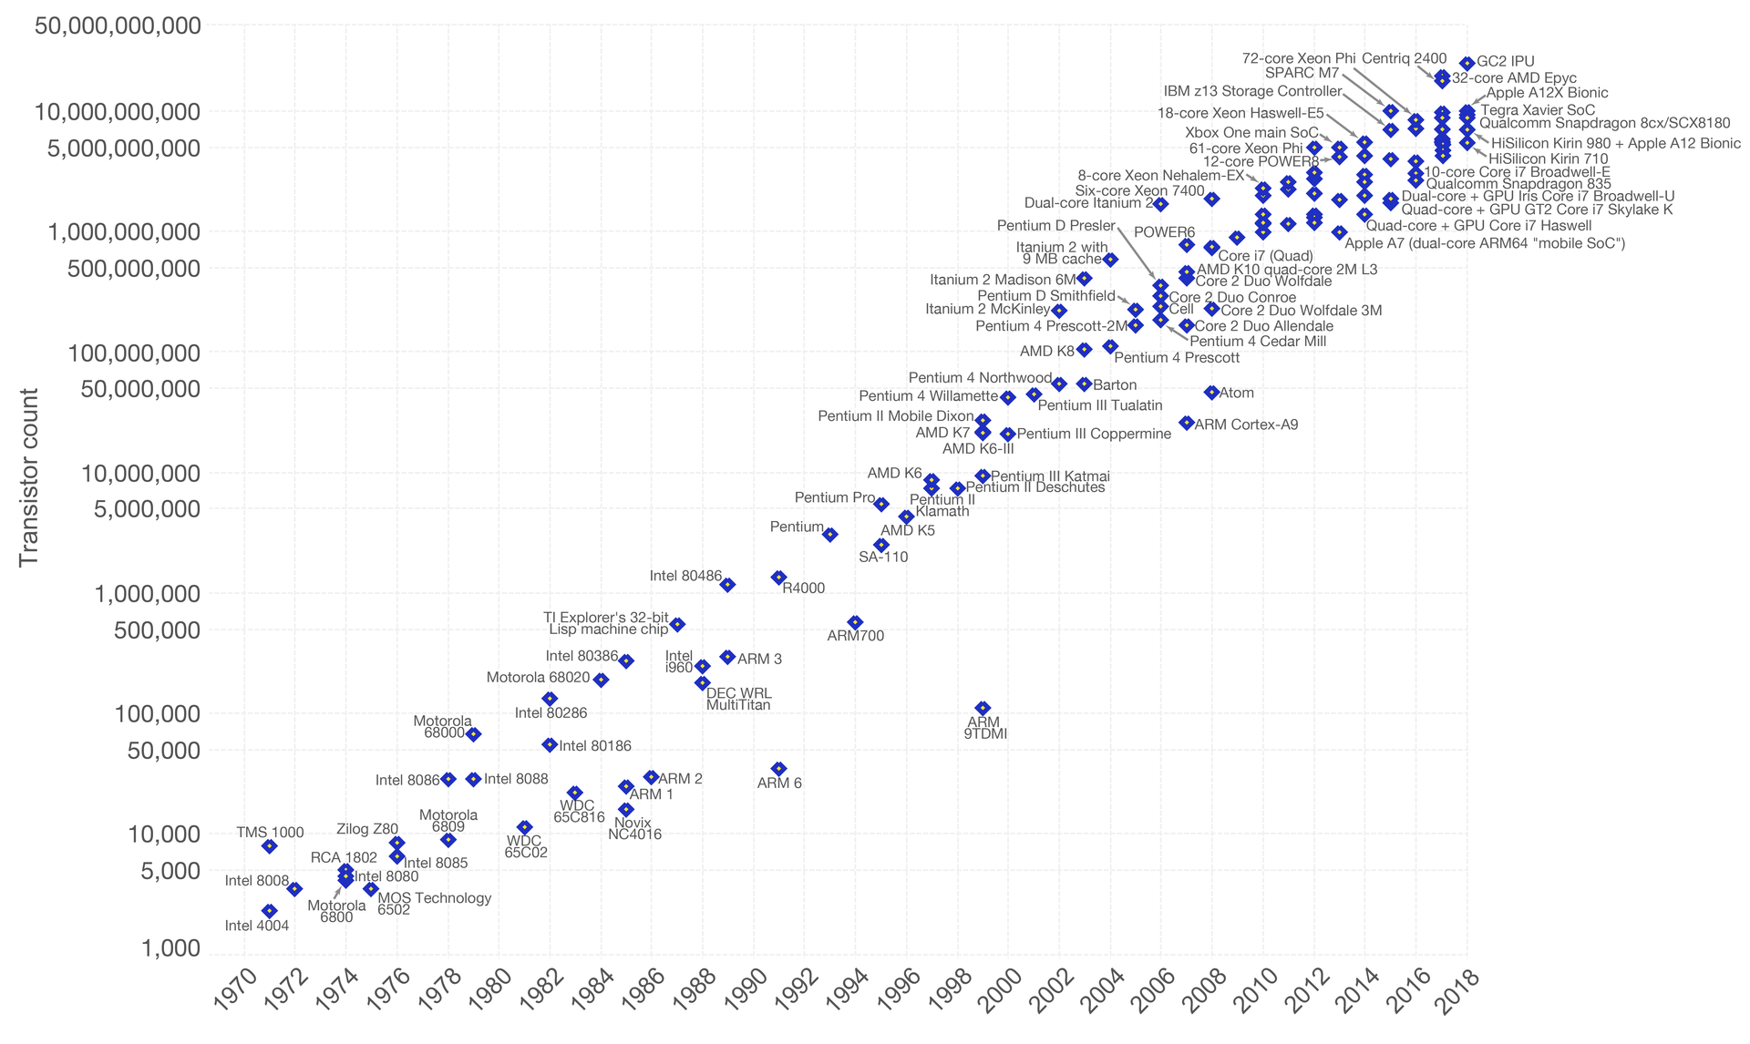

Slide 3

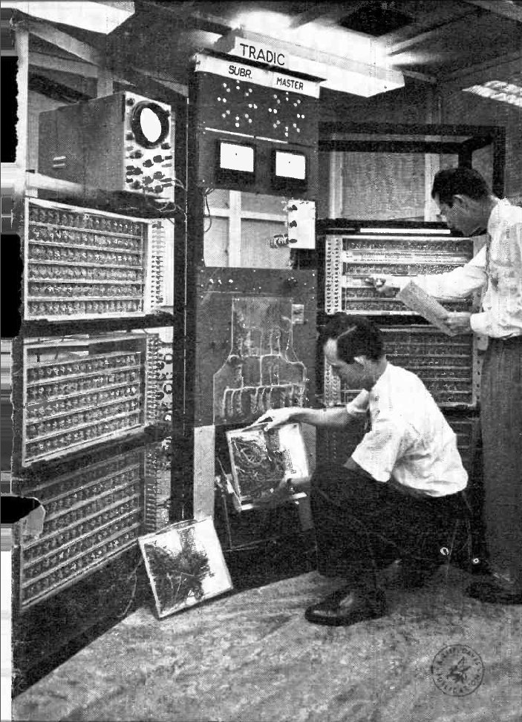
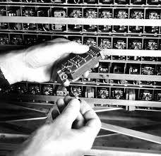
~14 nanometers
1954
~800 transistors

Slide 4
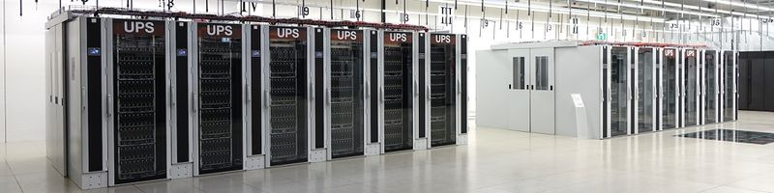
What is a computer cluster?

Slide 5
What is a computer cluster?
… it’s really just a set of computers connected together

Slide 6
computer 1
computer 2
computer 3
computer 4
computer 5
computer 6
computer 7
computer 8
computer 9

Slide 7
computer 1
computer 2
computer 3
computer 4
computer 5
computer 6
computer 7
computer 8
computer 9

Slide 8
computer 1
computer 2
computer 3
computer 4
computer 5
computer 6
computer 7
computer 8
head node

Slide 9
computer 1
computer 2
computer 3
computer 4
computer 5
computer 6
computer 7
computer 8
head node
Internet

Slide 10
computer 1
computer 2
computer 3
computer 4
storage 1
computer 5
computer 6
computer 7
storage 2
computer 8
head node
Internet

Slide 11
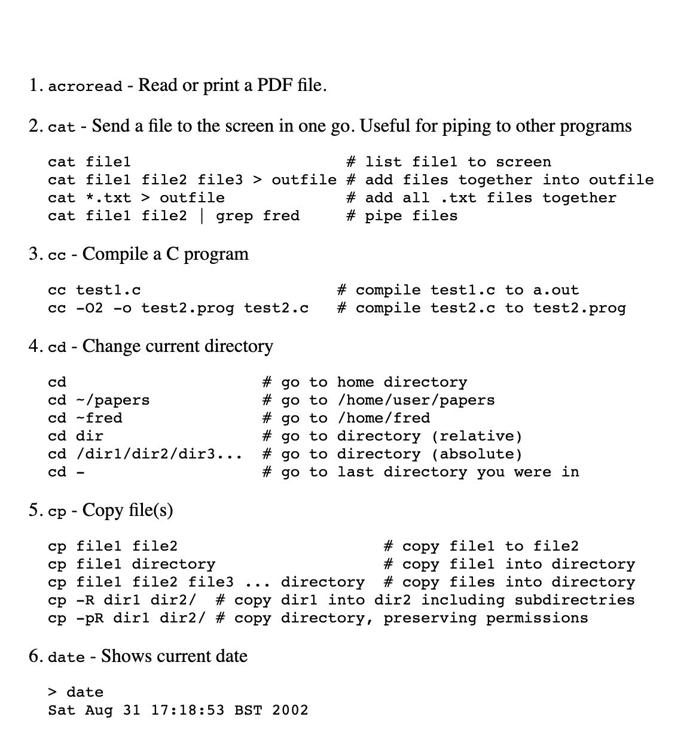
Basic Shell Commands
computer 1
computer 2
computer 3
computer 4
storage 1
computer 5
computer 6
computer 7
storage 2
computer 8
head node
Internet
. . .

Slide 12
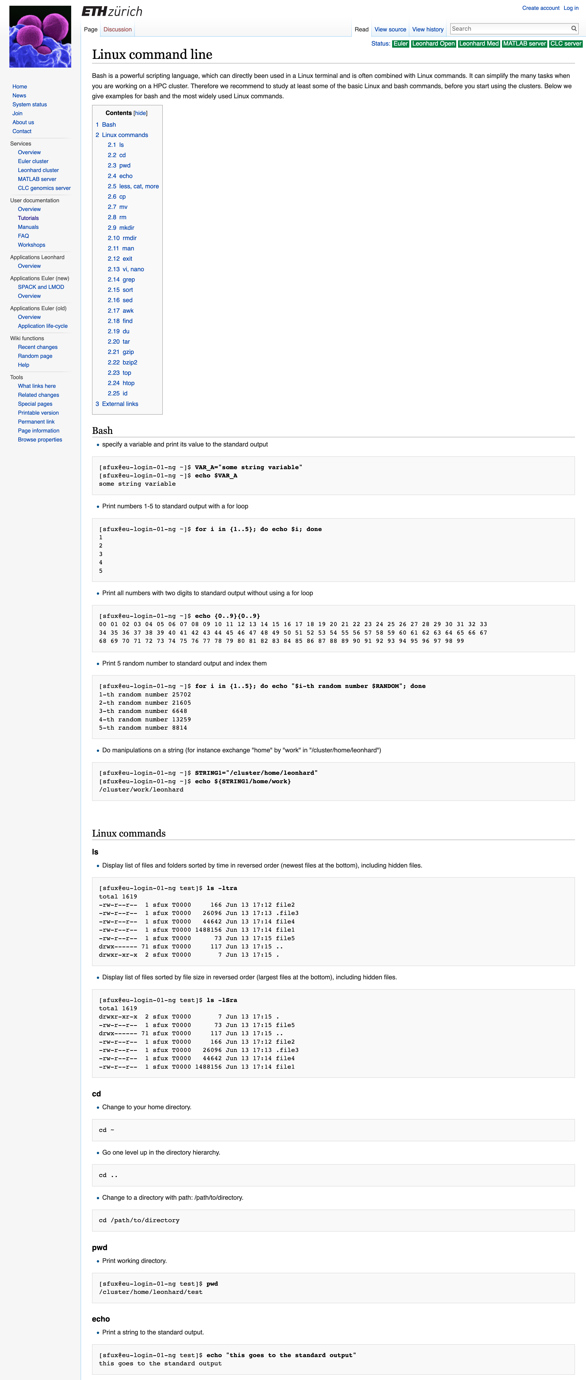

Slide 13
computer 1
computer 2
computer 3
computer 4
storage 1
computer 5
computer 6
computer 7
storage 2
computer 8
head node
Internet

Slide 14
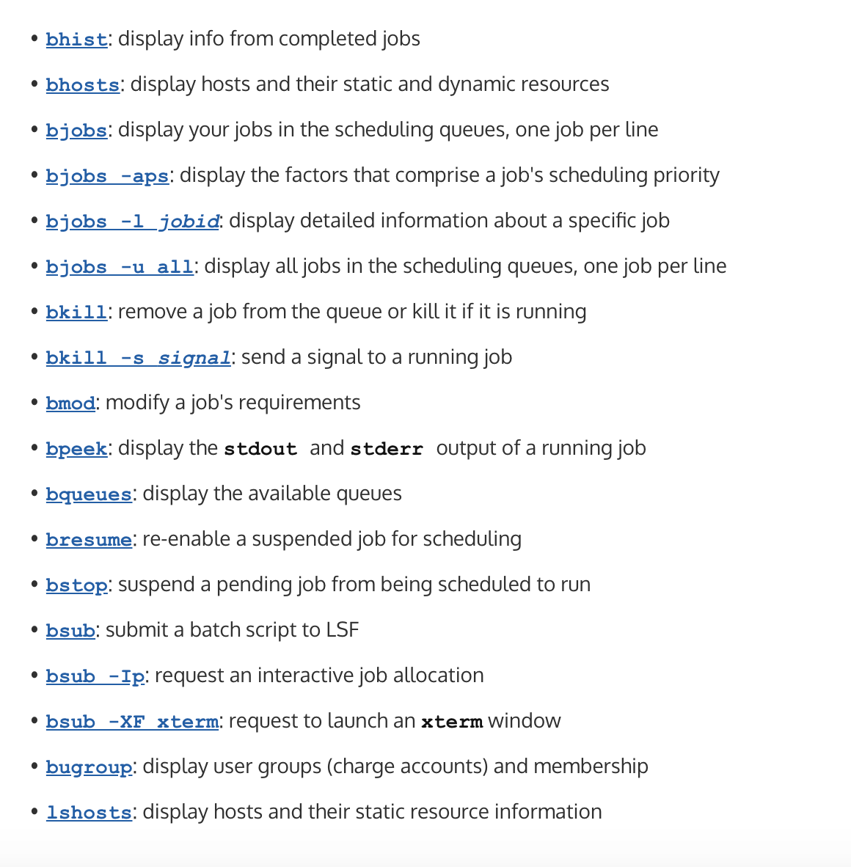
Using the Euler’s batch system
computer 1
computer 2
computer 3
computer 4
storage 1
computer 5
computer 6
computer 7
storage 2
computer 8
head node
Internet

Slide 15
Using the Euler’s batch system
computer 1
computer 2
computer 3
computer 4
storage 1
computer 5
computer 6
computer 7
storage 2
computer 8
head node
Internet

Slide 16
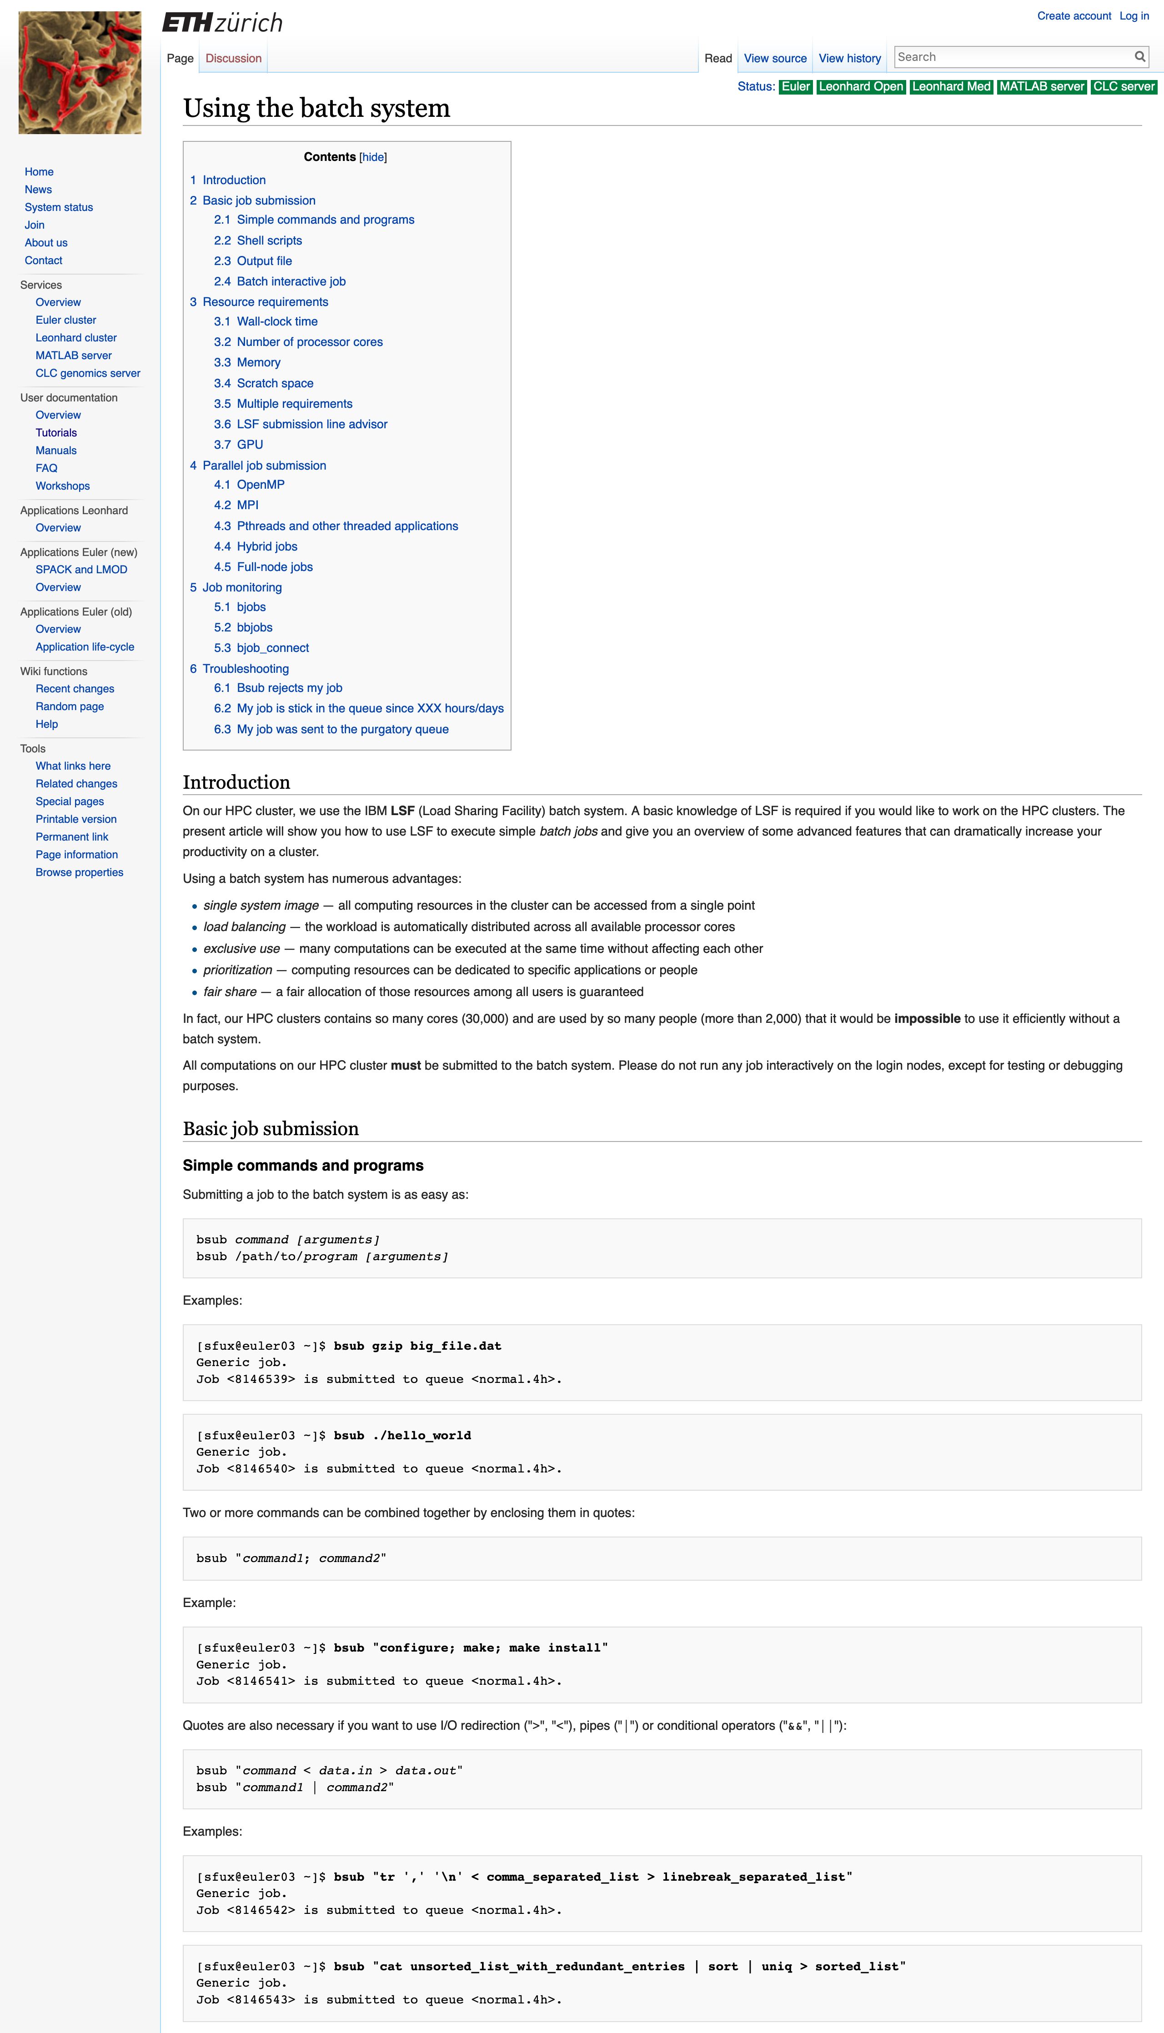

Slide 17


Slide 18
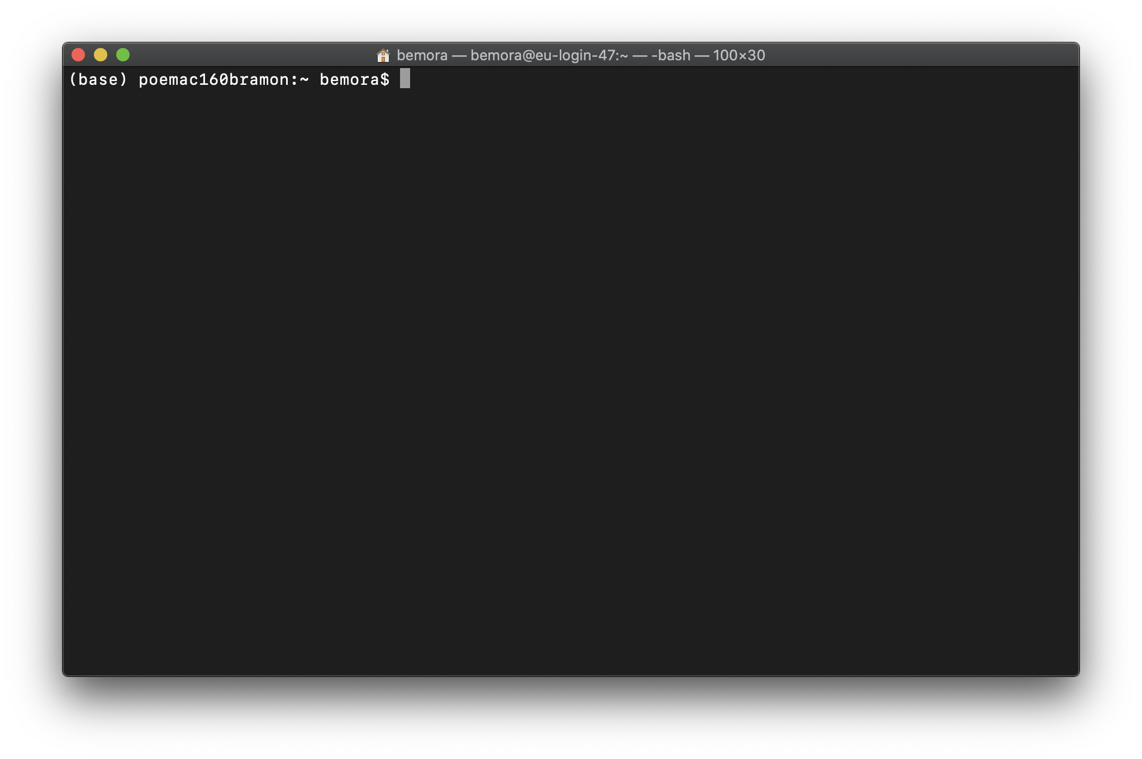
ssh

Slide 19
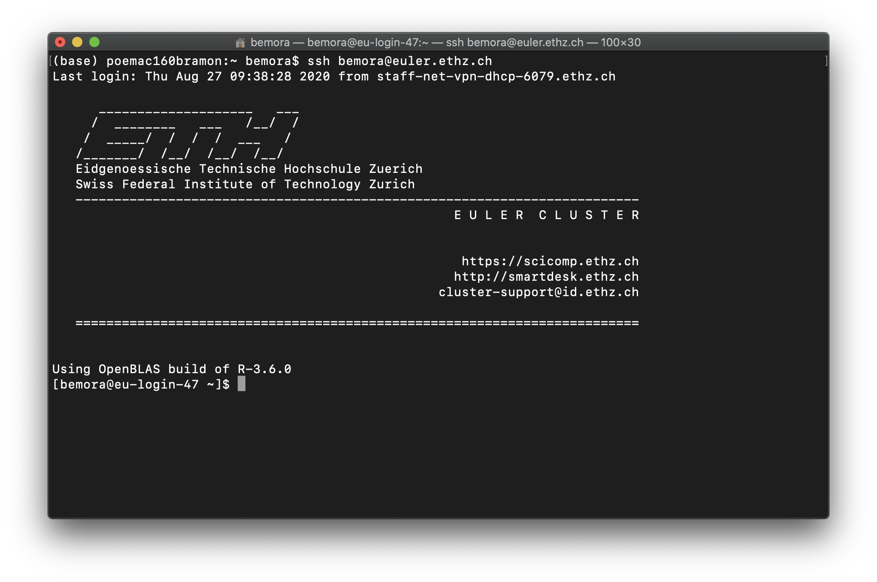
ssh

Slide 20
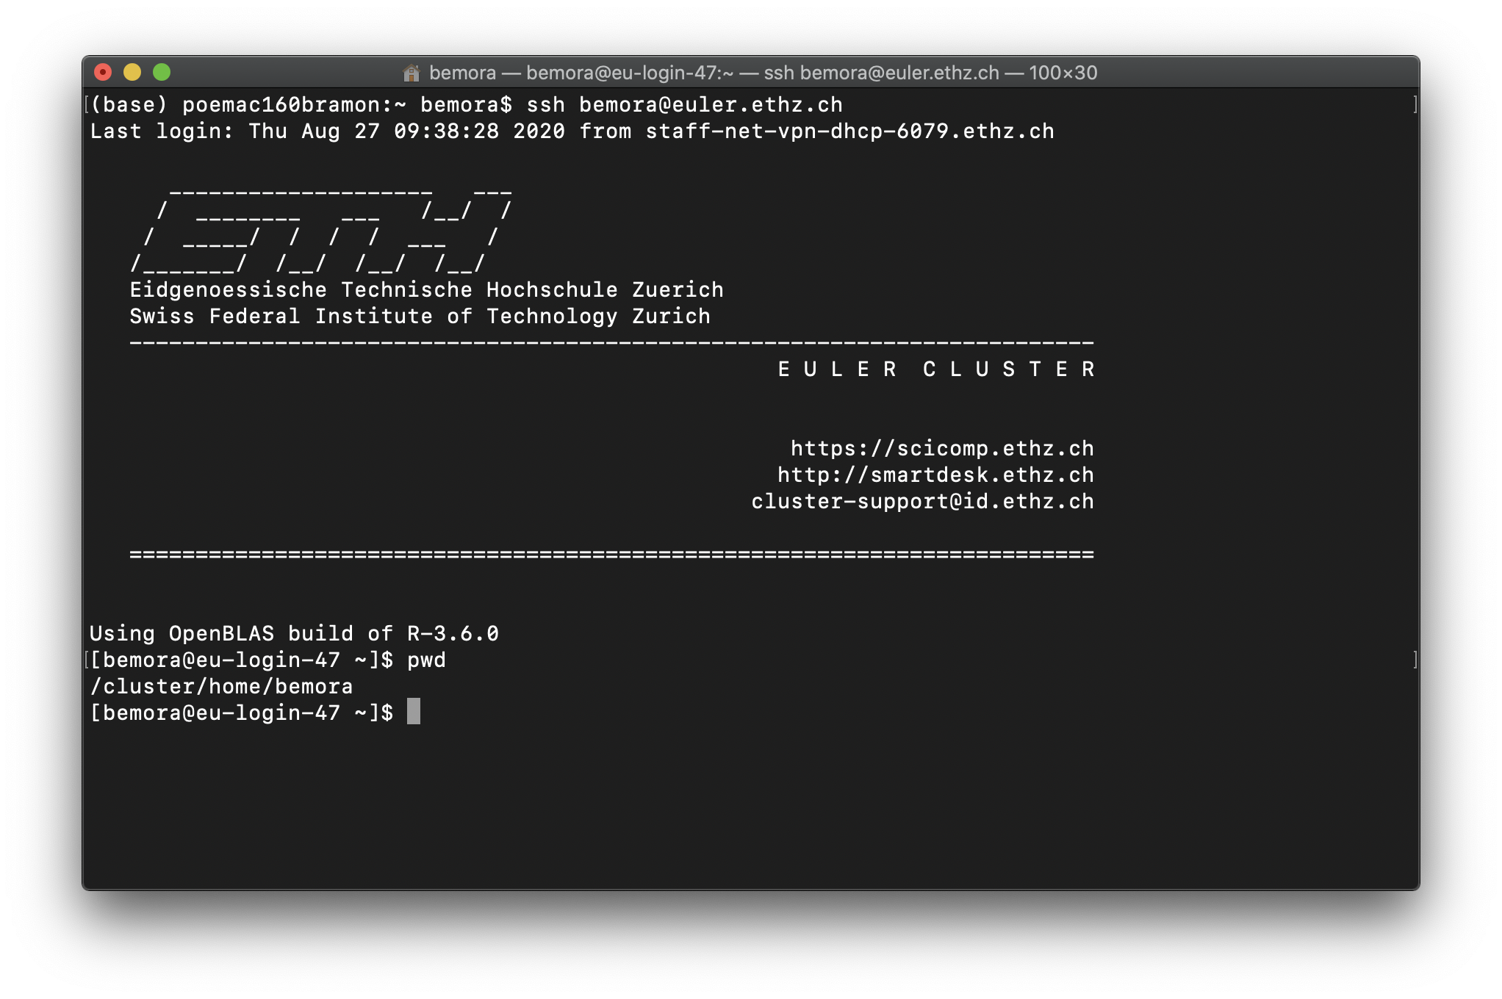
ssh

Slide 21
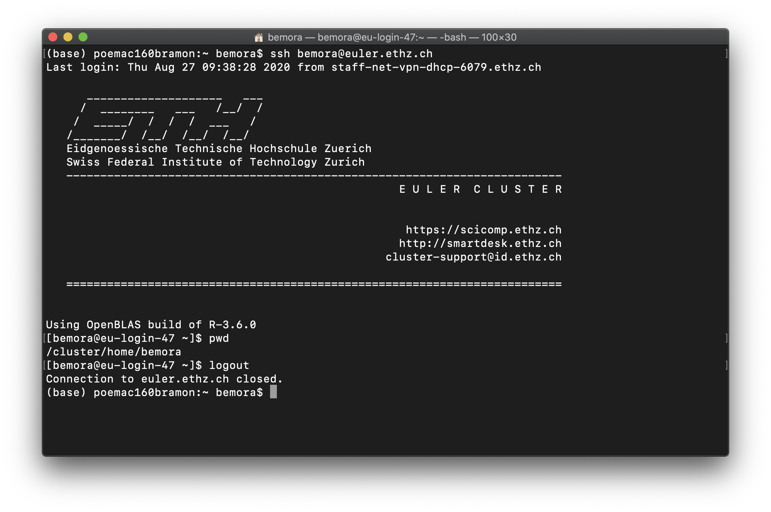
ssh

Slide 22
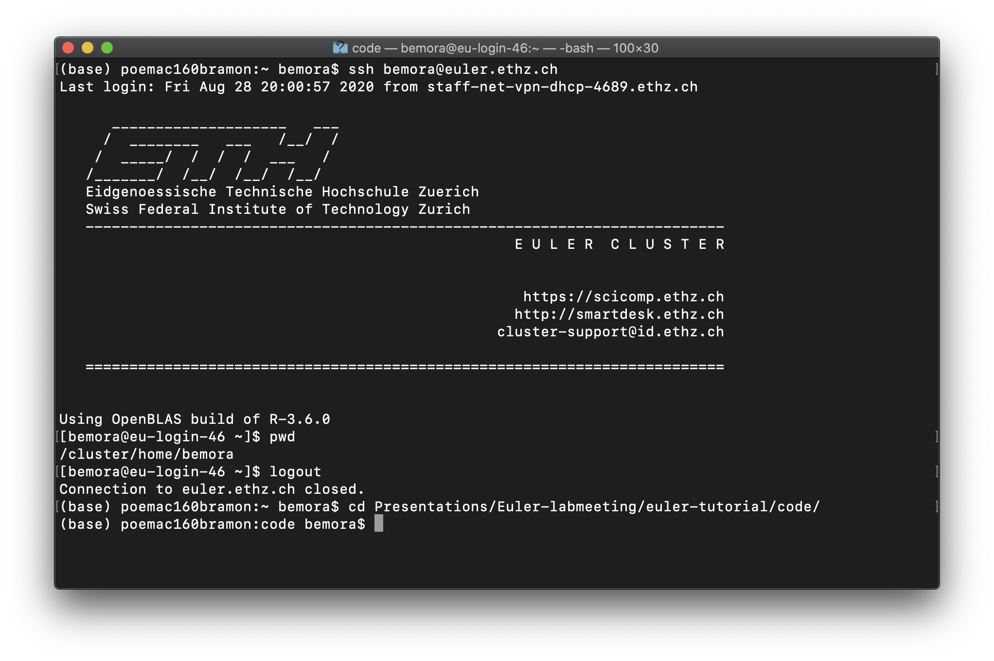
find your script…

Slide 23
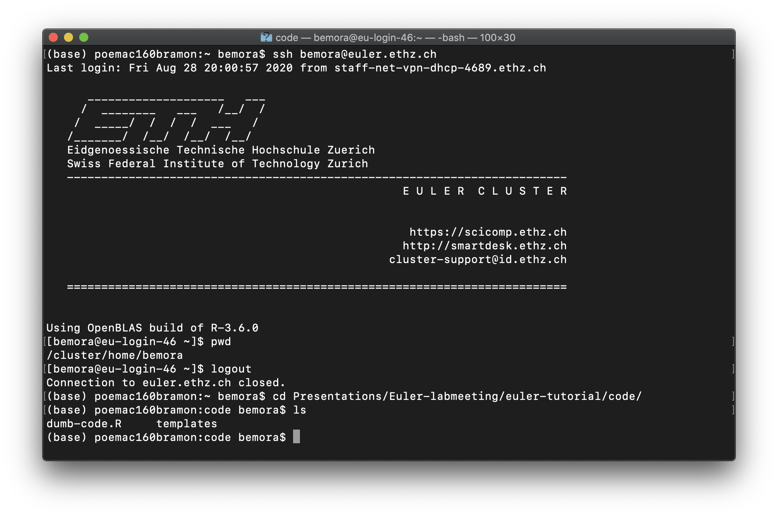
find your script…

Slide 24
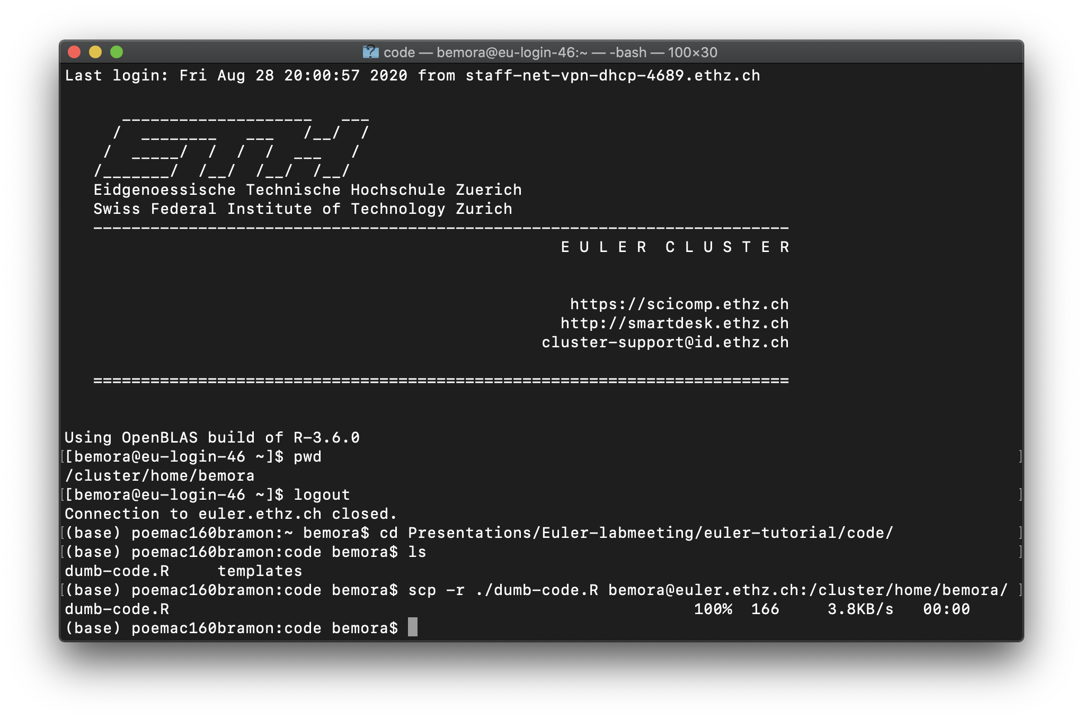
scp

Slide 25
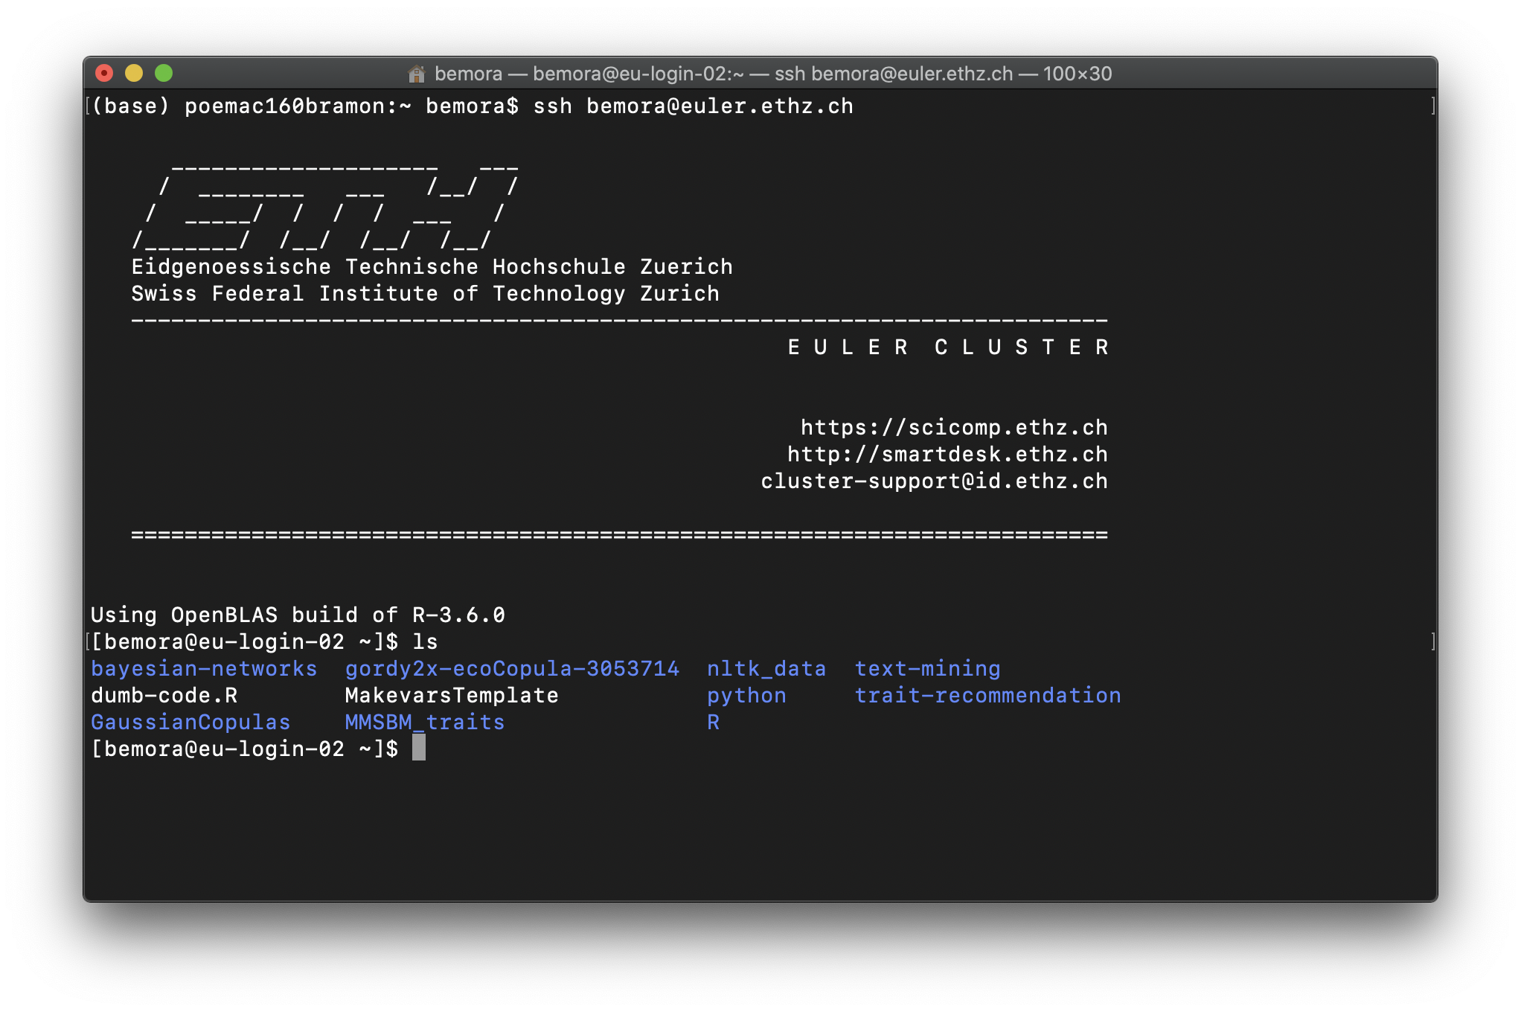
scp

Slide 26
scp

Slide 27
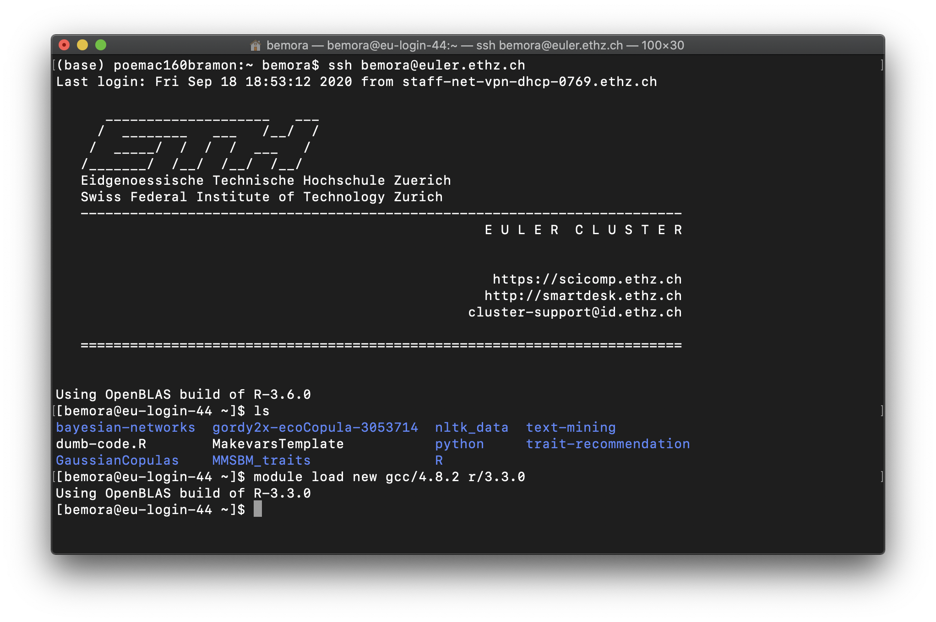
load R and compiler

Slide 28
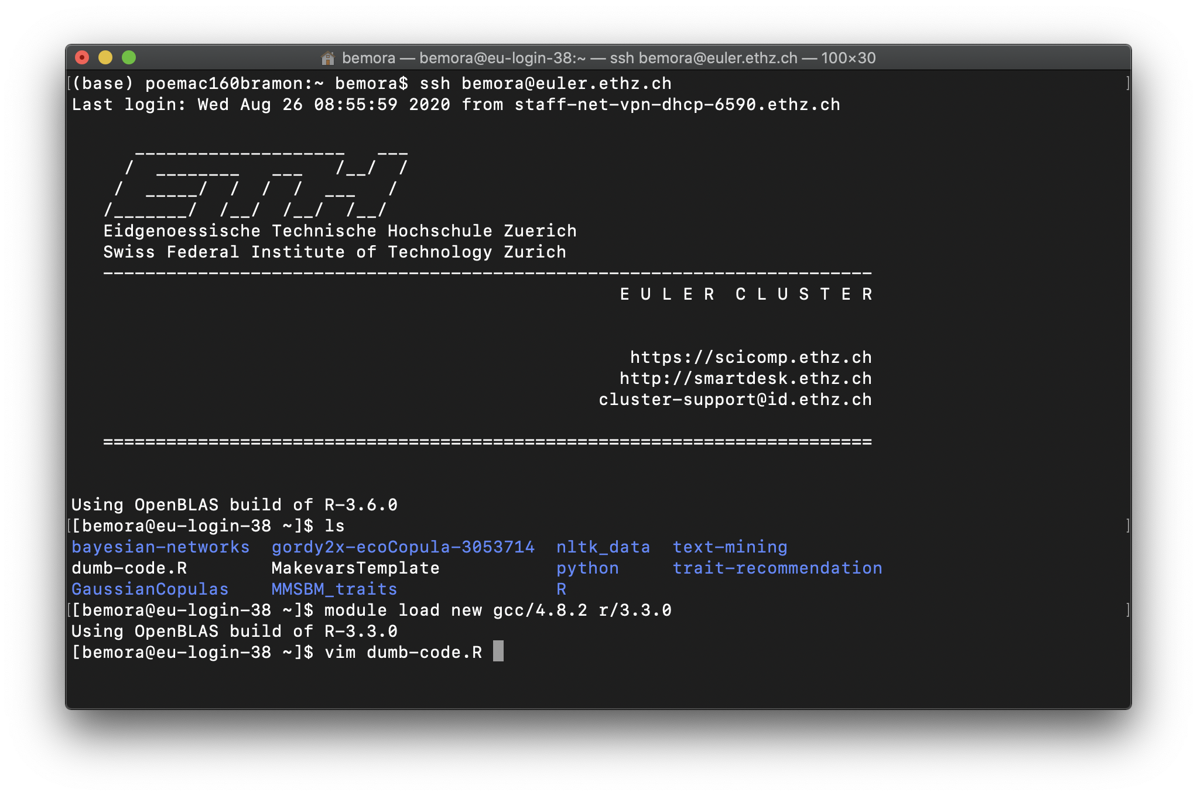
edit script

Slide 29
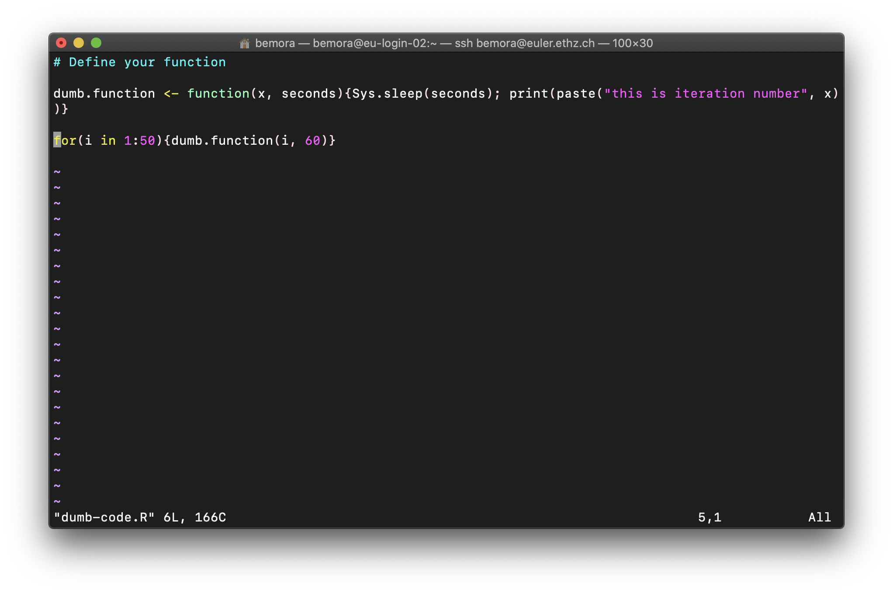
edit script

Slide 30
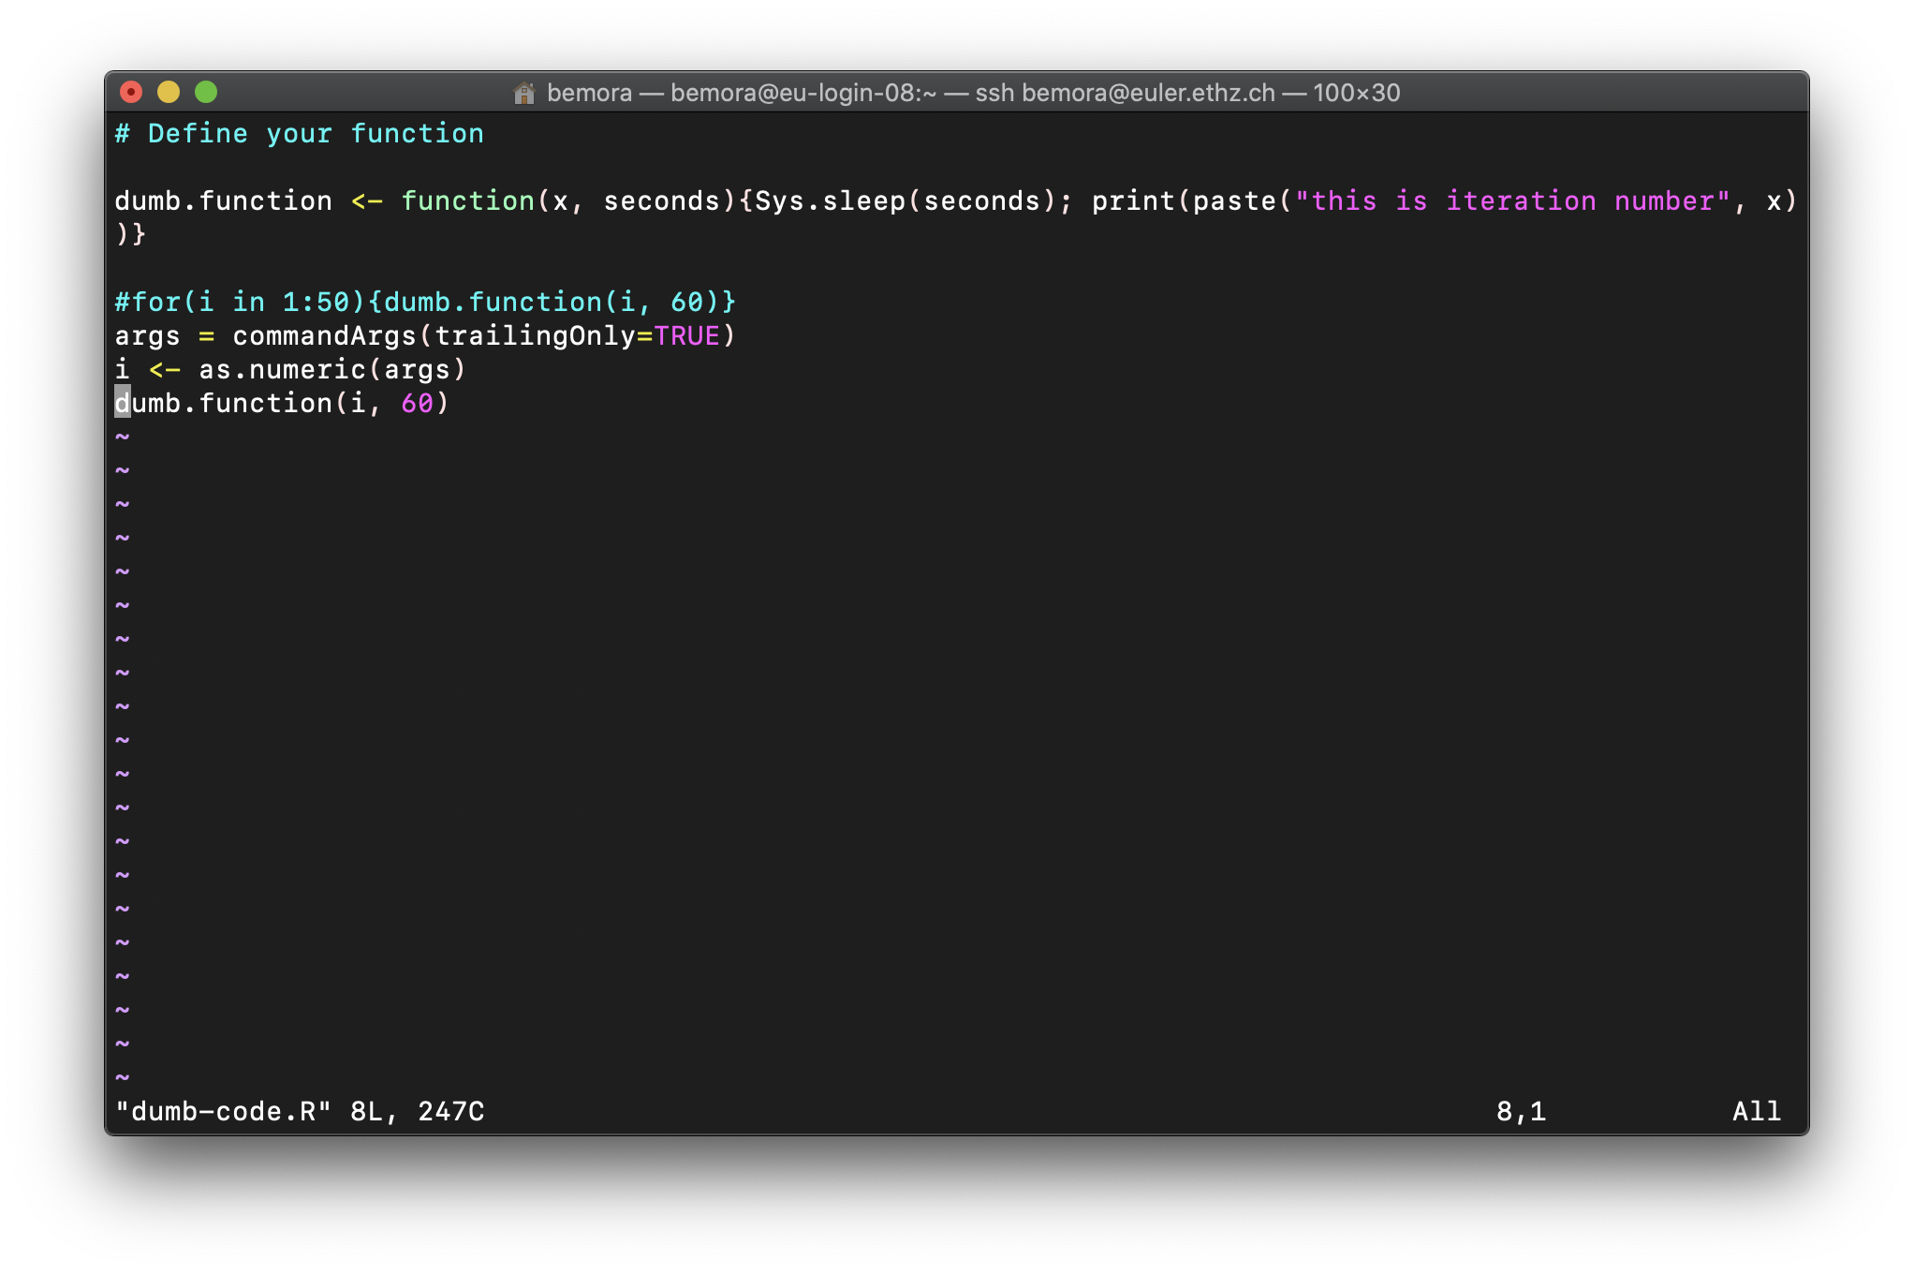
edit script

Slide 31
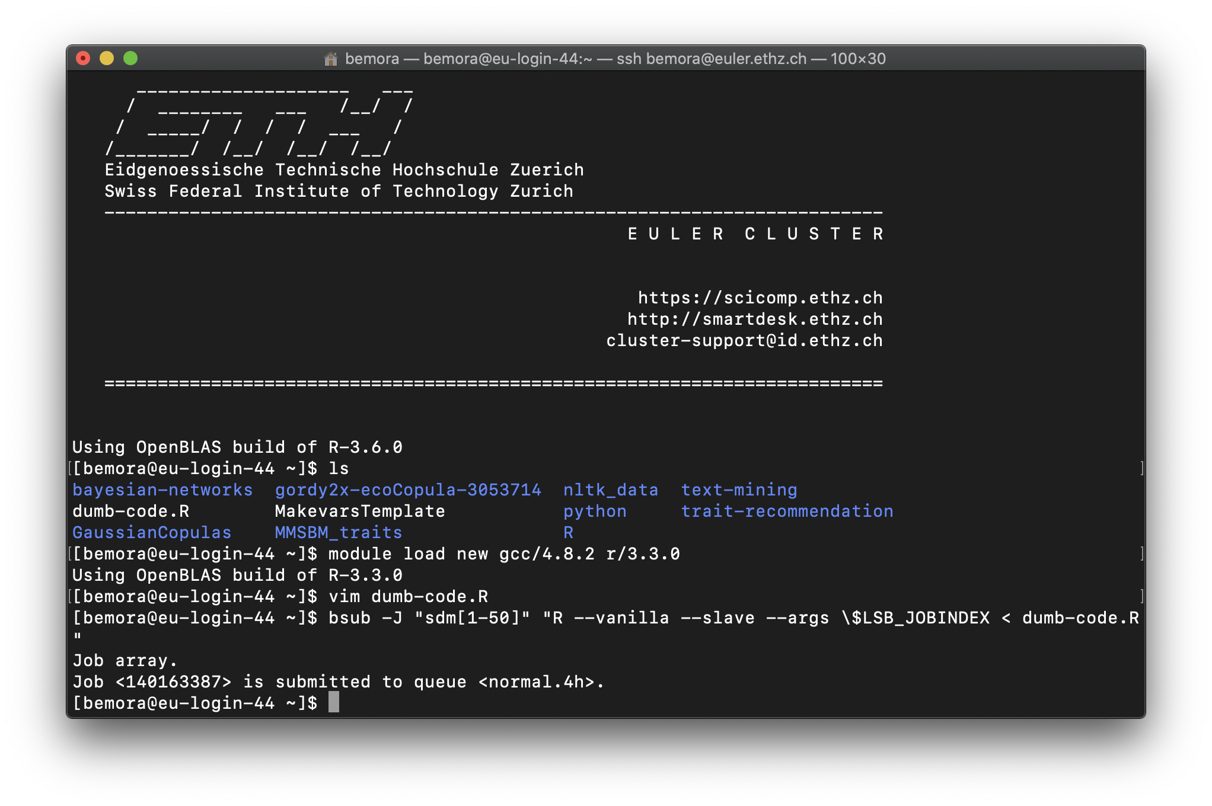
bsub

Slide 32
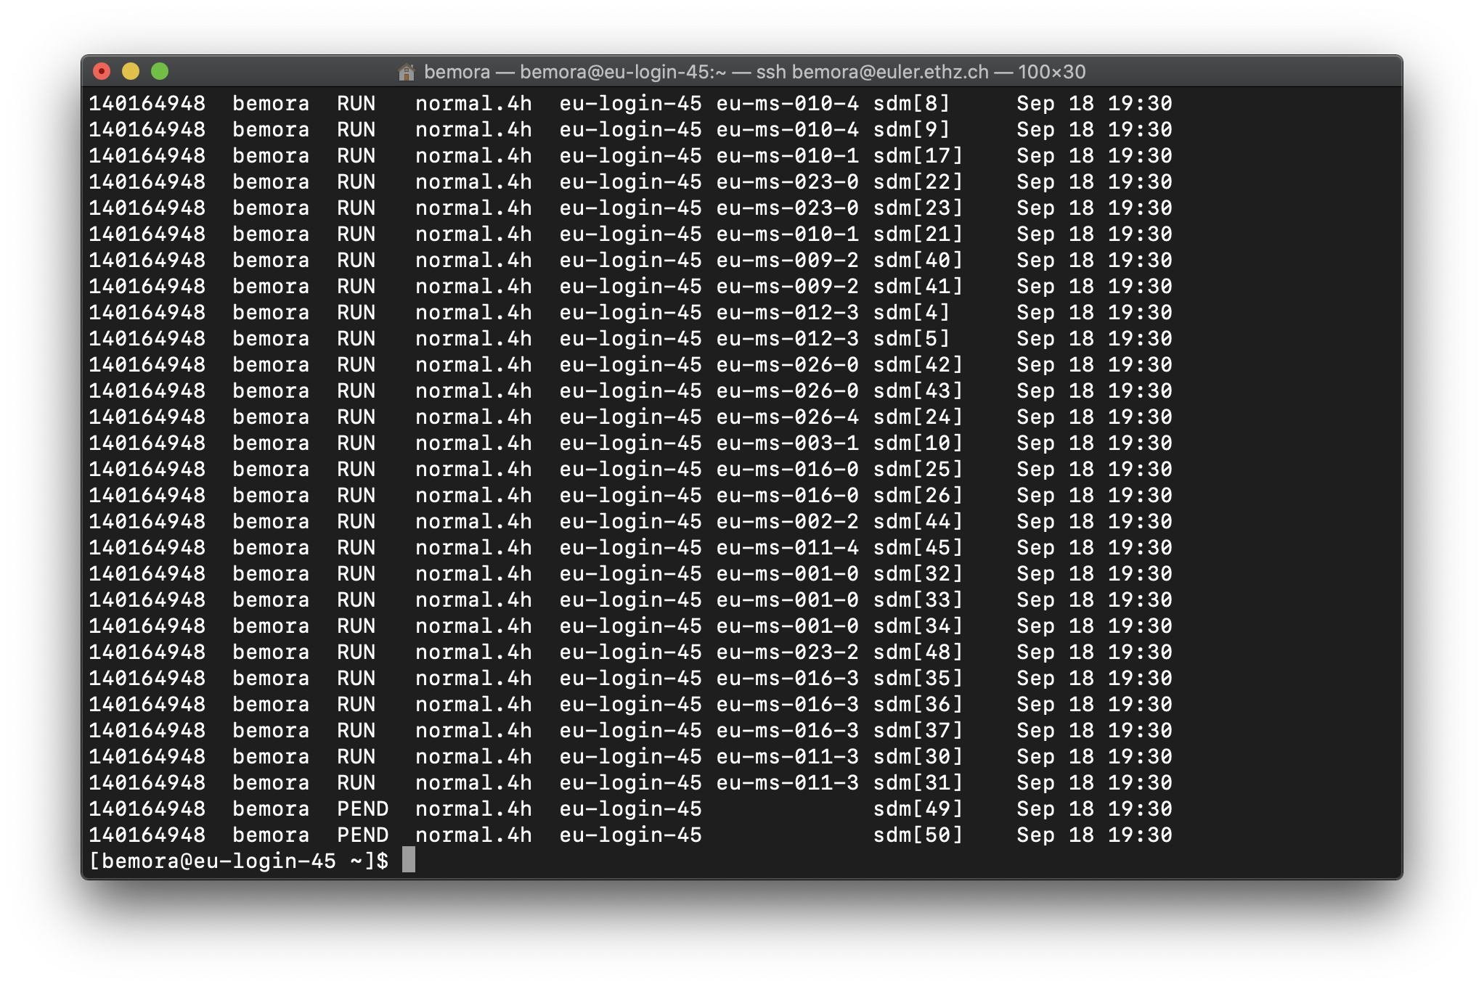
bjobs

